Slide 1


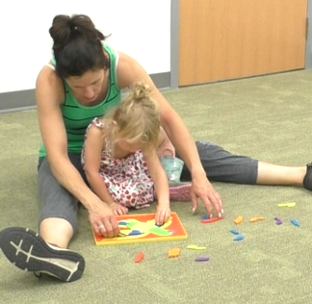
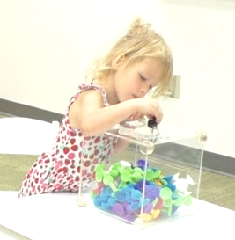
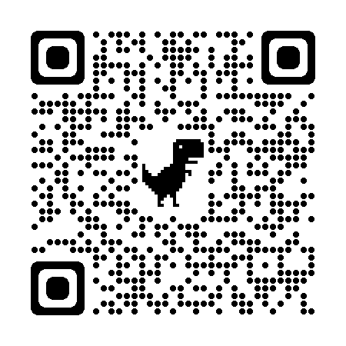



How much does parental sensitivity buffer the cortisol reactivity of ACEs exposed children from low-income communities?
Buffering the Cortisol Reactivity of ACEs Exposed Children from Low Income Communities:
The Role of Parental Sensitivity
P1 - 127
Maitri Jain, Angela Staples, Jamie Lawler
Eastern Michigan University
INTRODUCTION
Adverse Childhood Experiences (ACEs) increase the probability of dysregulated cortisol reactivity to stress in children (Brindle et al., 2022).
According to Attachment theory, parental sensitivity can buffer children’s cortisol reactivity (Gunnar & Hostinar, 2015).
Positive parenting has been found to buffer children’s cortisol reactivity in the context of child ACEs such as poverty (Blair et al., 2008; Brown et al., 2020) interpersonal violence (Hibel et al., 2011), parental divorce (Luecken et al. 2016), and early institutionalization (Hostinar et al., 2015; DePasquale et al., 2018).
However, there is no research looking at whether the buffering role of parental sensitivity is more or less pronounced at higher levels of cumulative adversity in children from low-income families.
AIM
To investigate the buffering effect of parental sensitivity on children’s cortisol reactivity at different level of ACEs in a sample of low-income families.
METHOD
PARTICIPANTS
n ~ 100 (Recruitment ongoing in Ypsilanti, Michigan).
Inclusion criteria:
Low SES
Parent: >18 years.
Child: 36-59 months.
Exclusion criterion:
Child/parent does not understand English.
Child has developmental delays or Autism Spectrum Disorder.
MEASURES
Expanded - Adverse Childhood Experiences (The Philadelphia ACE Task Force, 2013): 13 items. Home + Community level adversities.
Parent Sensitivity: Observationally coded from parent-child interaction throughout the two sessions (60+90 minutes) on a 5-point scale.
Stress task: Transparent box frustration task + interpersonal judgement.
Salivary Cortisol: On arrival, after 30 minutes, 55 minutes, 65 minutes, and 90 minutes.
EXPECTED RESULTS
DATA ANALYSIS
Latent piecewise growth analysis: Slopes of cortisol and the peak cortisol level.
Multi-level regression analysis: Interaction between ACEs score and parent sensitivity in association with peak cortisol and slope of cortisol.
Hypothesis 1: Higher number of ACEs experienced by children will be associated with more abnormal cortisol reactivity.
Hypothesis 2: Lower parental sensitivity will be associated with more abnormal cortisol reactivity in children.
Hypothesis 3: The buffering role of parental sensitivity in children’s cortisol reactivity will be particularly pronounced for children with higher ACEs.
DISCUSSION
If hypothesis 1 is supported, it will show that ACEs act in a cumulative manner, with a higher number of ACEs creating greater developmental challenges.
If hypothesis 2 is supported, it will highlight the important role of parental sensitivity in children’s development.
If hypothesis 3 is supported, it will bolster the importance of sensitive parenting even in children at high risk.
These results, if supported, will give us an effective point of parental interventions for at-risk children.
However, if our hypotheses are not supported, it will point to the need to look at other biological and environmental factors that impact the development of children’s HPA axis.
LIMITATIONS
Novel lab situation may affect cortisol levels.
Non-experimental design.
Child (n = 7) |  | Parent (n = 7)
Age (months) | Mean = 42.67 Range = 37-50 | Income | < 10k: 3 10-19k: 1 40-49k: 1 80-89k: 1 Unknown = 1
Race (number) | White: 3 Black: 3 Unknown = 1 | Race (number) | White: 4 Black: 3
Ethnicity (n Hispanic/Latinx) | 1 | Ethnicity (n Hispanic/Latinx) | 1
ACEs Total Score | Mean = 5.4 Range = 2-9 | Education (number) | High school: 2 Some college: 4 Unknown = 1
 |  | Parent Sensitivity | Mean = 3.8 Range = 2-5
Wow, you still haven’t gotten it open? Usually even little kids can do it!
mjain2@emich.edu @MaitriJain99 Maitrijain99
Notes:
Notes:
In Powerpoint, click View > Guides
Keep text within gutter guides.
Author list: Don’t split names onto two lines (e.g., “Jimmy [break] Smith”). If that happens, use a new line, unless you need the space. Bold the first names of anybody who’s presenting in person.
Intro/methods/result: Do not drop below font size 28, but if you have extra space, jack up the font size until the space is full.
Do not use color in the sidebars except in graphs/figures. It’ll pull attention from the center and slow interpretation for passersby.

